Slide 1
Imagine Design Workshop
Plan to Produce | Energy Production cycle demo
29/08/2025

Slide 2
Agenda
Sr. No | Topic | Presented by
1 | Energy production cycle | Juan Pablo Bernal Nino

Slide 3
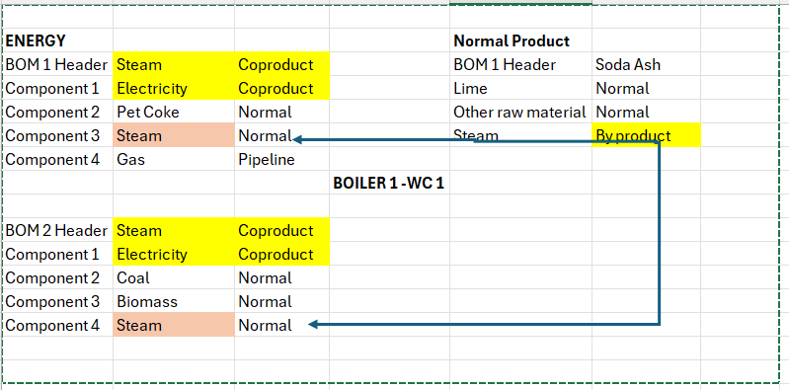
Energy Production cycle
BOM structure
A Bill of Materials (BOM) is a comprehensive list of raw materials, components, and assemblies required to build or manufacture a product. In the context of energy production, the BOM is divided into sections for energy and normal products, each with specific headers and components.

Slide 4
Energy Production Cycle
Normal Soda Ash Production BOM
BOM 1 Header - Soda Ash: A normal product.
Components:
  Lime: Normal input.
  Other Raw Material (SALT): Normal input.
  Steam: Byproduct, indicating it is produced incidentally during the manufacturing process
Co-product: Items like steam and electricity are produced simultaneously with other products, highlighting their role in energy generation or manufacturing processes.
Normal Inputs: Materials such as Pet Coke, Coal, Biomass, and Lime are standard inputs necessary for the production process.
Byproducts: Steam is identified as a byproduct in the normal product BOM, which can be utilized or sold separately.

Slide 5
Energy Production Cycle
Energy BOM structure
Energy can be produced with multiple combination of components. Here we have created 2 BOM for production
1. BOM 1 Header - Steam: Coproduced item, indicating it is produced alongside other products.
Components:
  Electricity: Also a Coproduced item.
  Pet Coke: Normal, suggesting it's a standard input.
  Steam: Normal, indicating typical usage.
  Gas: Pipeline, showing a different method of supply.
2. BOM 2 Header - Steam: Again, a Coproduced item.
Components:
  Electricity: Coproduced.
  Coal: Normal input.
  Biomass: Normal input.
  Steam: Normal usage.

Slide 6
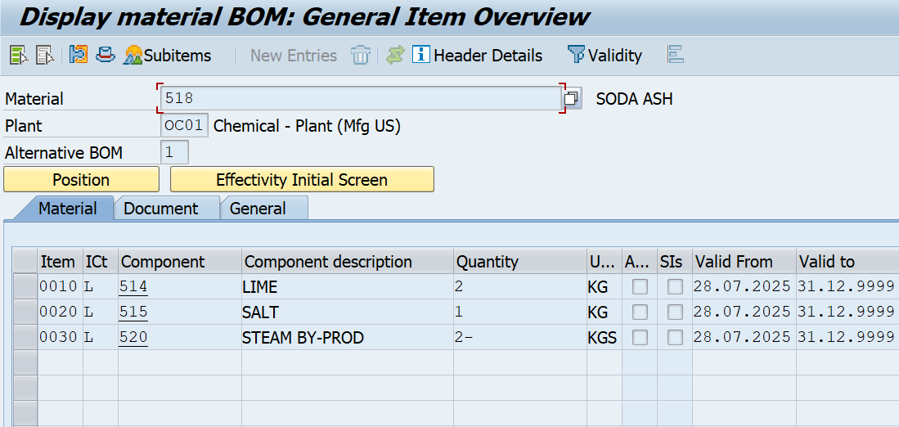
Energy Production Cycle
Soda Ash BOM:

Slide 7
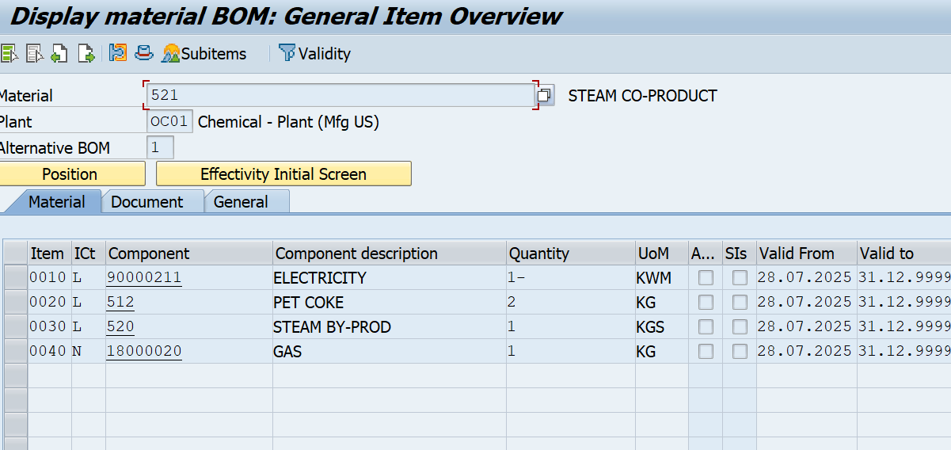
Energy Production Cycle
Energy BOM in SAP
Alternative BOM 1:

Slide 8
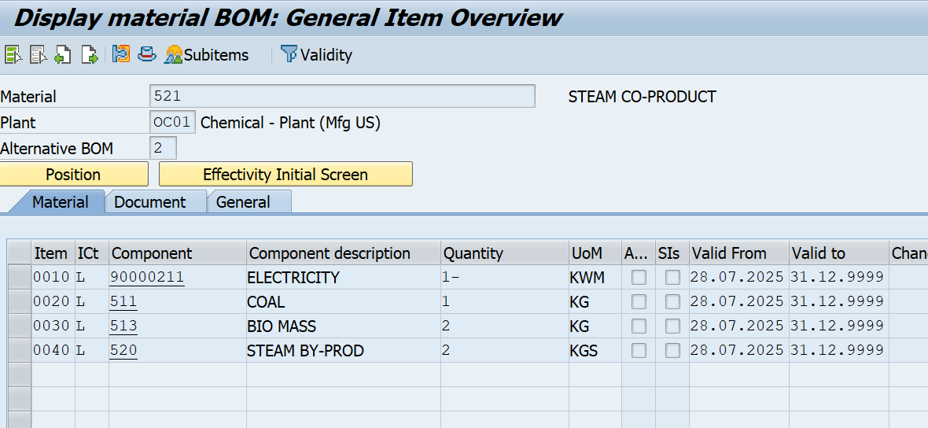
Energy Production Cycle
Energy BOM in SAP
Alternative BOM 2:

Slide 9
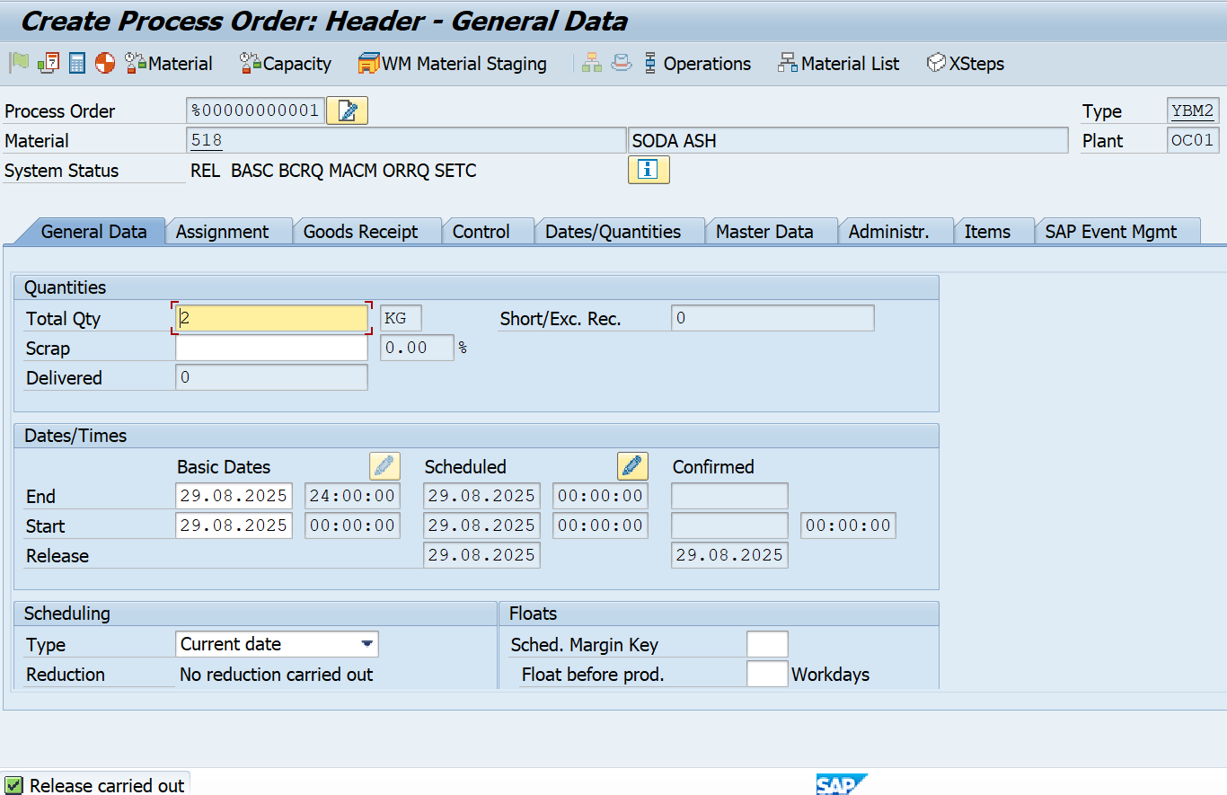
Energy Production Cycle
Soda Ash Process Order :

Slide 10
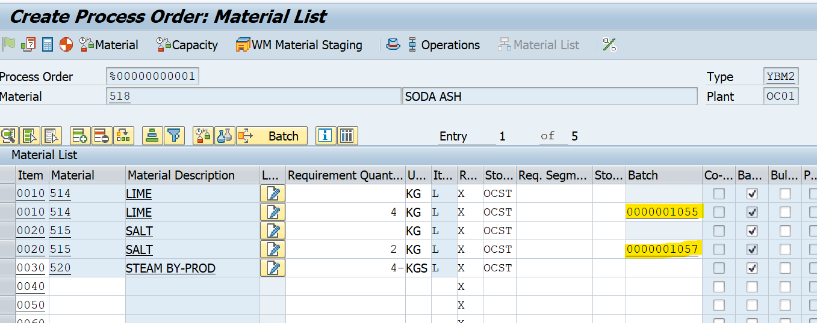
Energy Production Cycle
Auto Batch Determination for components :

Slide 11
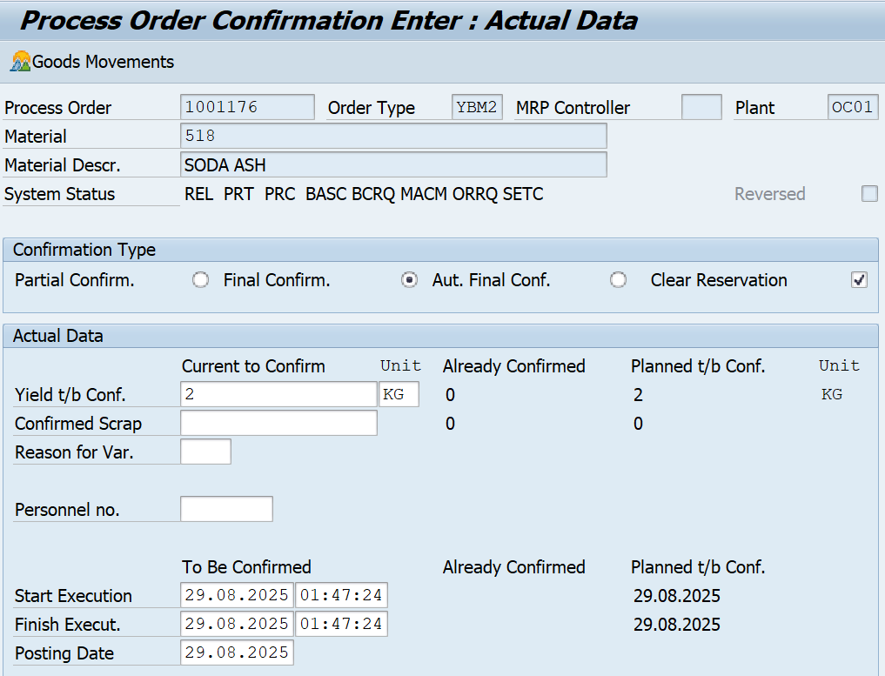
Energy Production Cycle
Final Confirmation of Order :

Slide 12
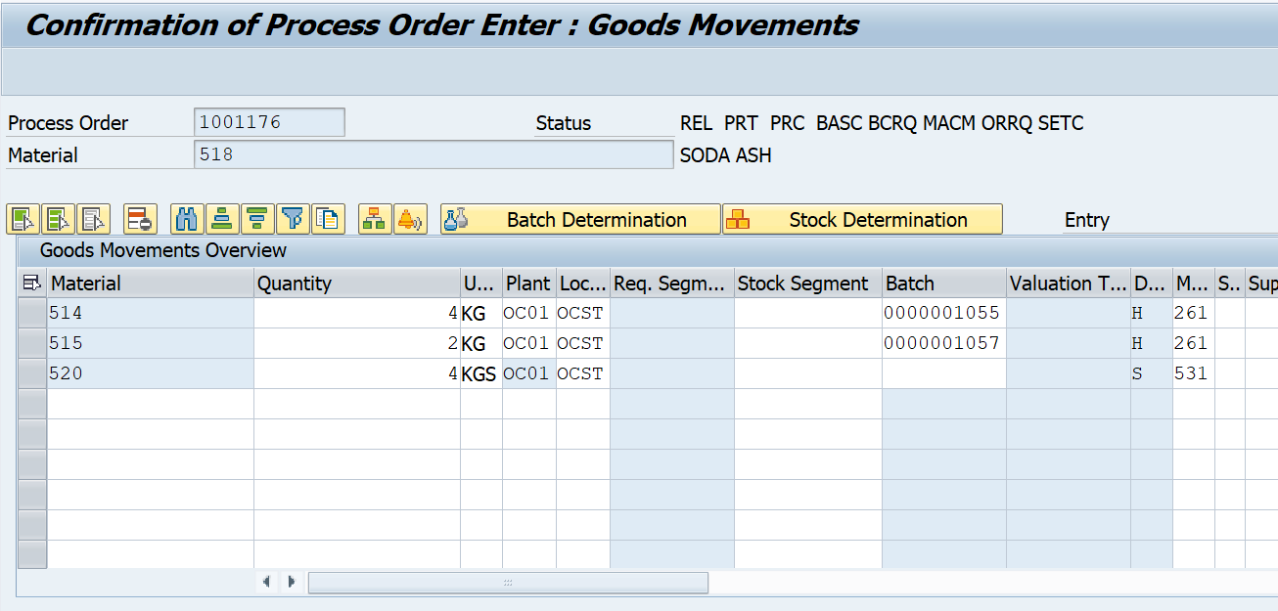
Energy Production Cycle
Auto Goods Movement for Consumption :

Slide 13
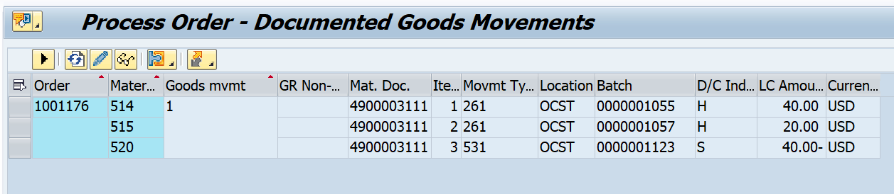
Energy Production Cycle
Goods Movement posted for Consumption :
Steam is produced as By-product with movement type 531

Slide 14
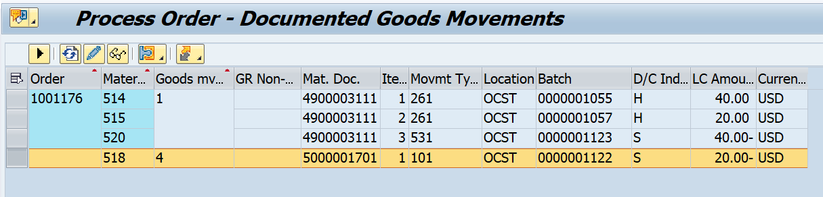
Energy Production Cycle
Goods Receipt Posted:

Slide 15
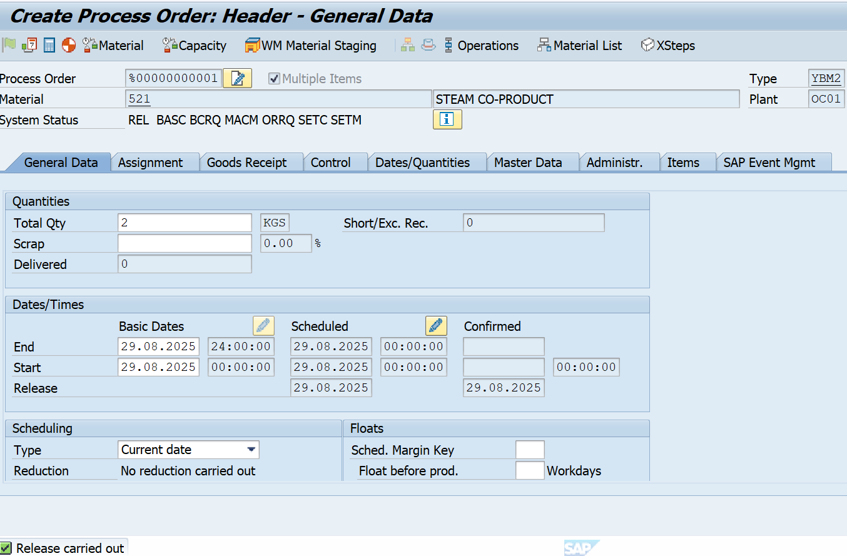
Energy Production Cycle
Process order for Energy:

Slide 16
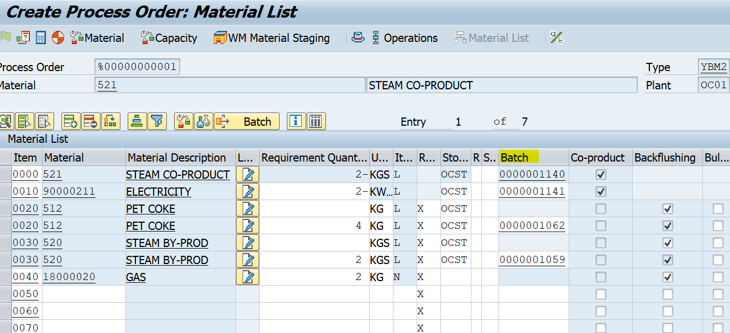
Energy Production Cycle
Batch determination of components:

Slide 17
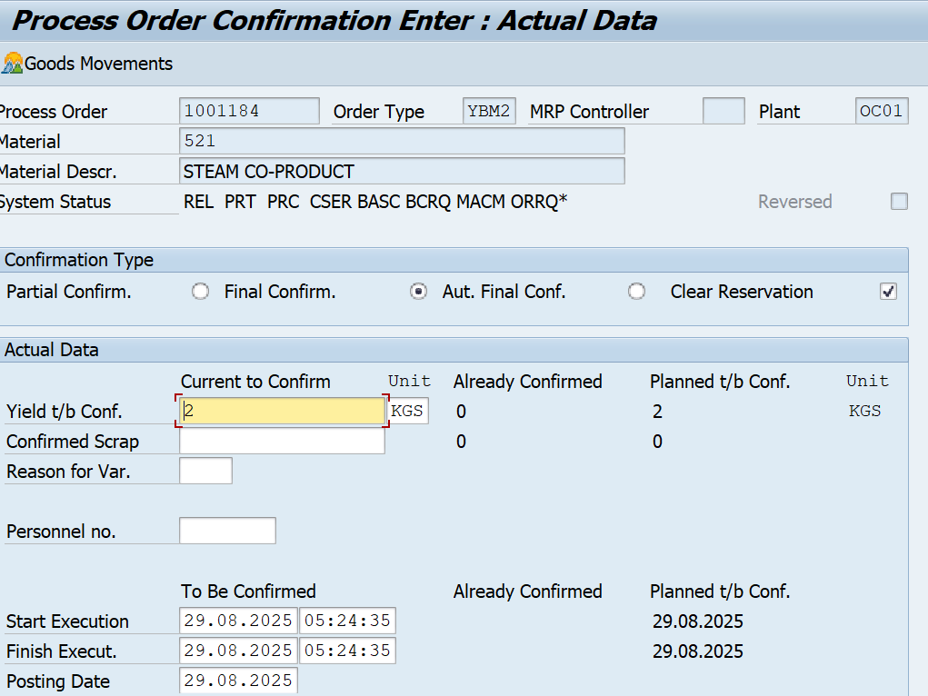
Energy Production Cycle
Final Confirmation of process order:

Slide 18
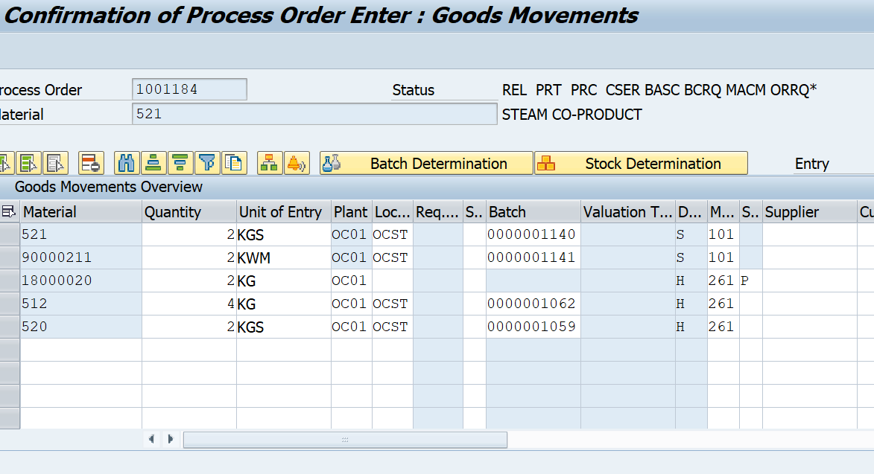
Energy Production Cycle
Auto Goods movement (GR/GI) taking place at the time of Confirmation:

Slide 19
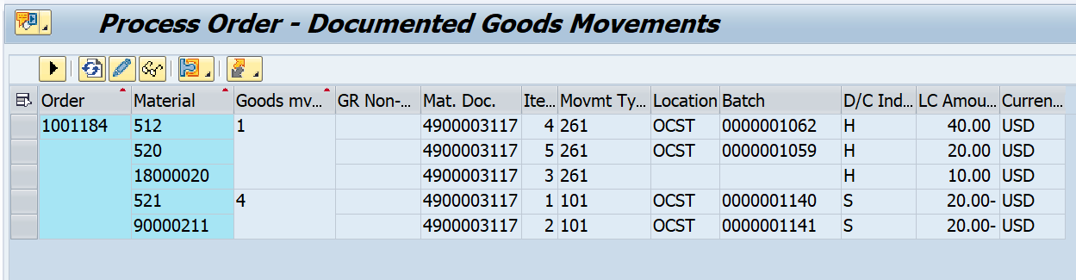
Energy Production Cycle
Auto Goods movement (GR/GI) posted for process order:

Slide 20


Thank you

